Slide 1
cleavage
    Dr.Lubal M.J.
    Research Guide
    Head
    Dept.of Zoology
    Dahiwadi College Dahiwadi
    (B.Sc.lll)

Slide 2
Definition :
Cleavage is a process of rapid and synchronous mitotic cell divisions of the zygote to form numerous cells for building up the offspring’s body
Cleavage differs from other forms of cell division in that it increases the number of cells without increasing the mass.
Cleavage ends with the formation of the blastula.

Slide 3
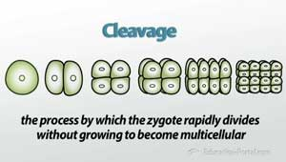

Slide 4
CHARACTERISTICS OF CLEAVAGE:
All the divisions of the zygote are mitotic and occurs in quick succession.
Interphase in cleavage divisions is very short and does not involve of growth so that the resulting blastomeres becomes smaller in size as their number increases.
The total cytoplasmic mass remains the same as in the zygote.
Cleavage divisions clearly differs from the ordinary mitotic divisions in which the daughter cells grow to normal size before the next division can occur.

Slide 5
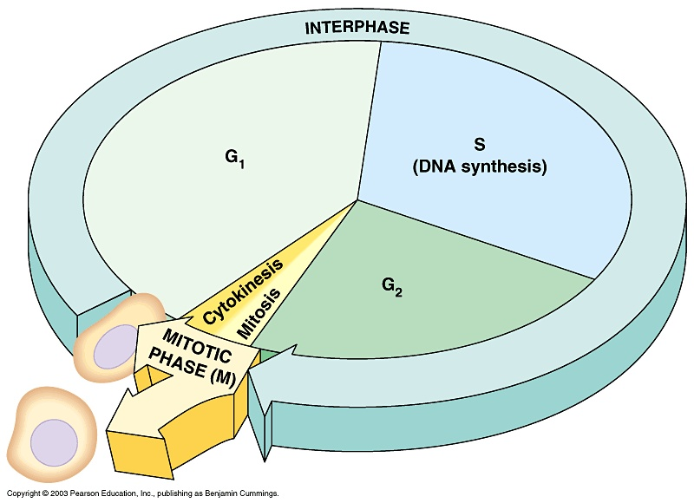
Somatic cell cycle:

Slide 6
Somatic cell cycle contains 4 phases: G1, S, G2 and M .
The cleavage cell cycle comprises only 2 phases : M and S.
M and S phases of cleavge cell cycle are shorter than those of somatic cell cycle.
The ratio of nuclear mass to cytoplasmic mass is very low for the zygote .
During cleavage nuclear material increases as the new nucleus is formed for each blastomere as a results nuclear/cytoplasmic ratio increases.This makes a cell more active metabolically.

Slide 7
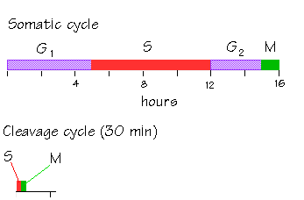

Slide 8
Shape of the embryo does not change during cleavage because there is no movement of blastomeres.
Early cleavage is regular and synchronous i.e. all the blastomeres divides simultaneously.
With the result no. of blastomeres doubles{2,4,8,16,32,64} at each cleavage.
Cleavage becomes irregular so that the blastomeres no longer double at regular interphase.
In amphibians there is an abrupt change in the duration and synchrony of the cell cycle which is called mid-blastula transistion{MBT}.
DNA synthesis occurs faster during cleavage to facilitate duplication of chromosomes for rapid cell divisions.

Slide 9
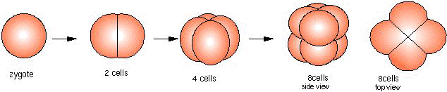
Doubling of blastomeres:

Slide 10
Cleavage besides producing a large no. of cells by rapid divisions also seggregates different substances present n the cytoplasm of the zygote into different cells.
Consumption of oxygen greatly increases during cleavage to provide adequate energy for the activity taking place in the cell diviosion.
The blastomeres remains adhered together during cleavage.

Slide 11
Synthesis of nucleic acid in cleavage:
The chemical composition of embryo does not undergoes any qualitative change during cleavage.
The amount of DNA increases since there is rapid increase in number of nuclei .
Only limited amounts of mRNA and tRNA are synthesized during cleavage but little or no rRNA is produced untill the onset of gastrulation.
The protein synthesis that occurs in cleavage is directed by maternal mRNA contributed by egg .
This mRNA is masked in the unfertilized egg to check protein synthesis and is unmasked after fertilization to permit protein synthesis which is necessary for cleavage.

Slide 12
Mechanism of cleavage:
Cell division involves 2 processes :
Karyokinesis :
It is the division of nucleus .
It is controlled by mitotic apparatus which consists of spindle fibres with centriole pair at each pole and aster rays.
During mitosis chromosomes attach to spindle fibres becomes alligned at metaphase plate.
The nuclear envelope breaks down during prophase of each mitotic division and reforms after karyokinesis in a 2 step process.

Slide 13
A nuclear envelope is assembled around each chromosme which is called chromosomal vesicle.
Enough nuclear envelope precursors are stored in the ooplasm.

Slide 14
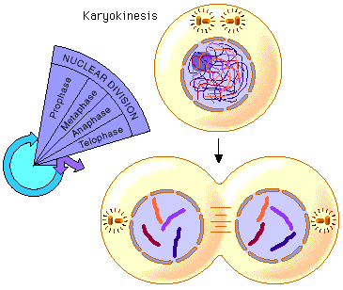
KARYOKINESIS:

Slide 15
Cytokinesis:
It is the division of cytoplasm .
A constriction of the egg surface called cleavage furrow appears between the two forming daughter nuclei and splitts the egg into 2 cells during telophase.
The cleavage furrow results from the contractile ring which appears during cytokinesis.
Different mechanisms are used for expanding the cell membrane.
The end of cleavage coincides with the beginning of zygotic transcription.
While mitosis can occur in the absence of cytokinesis, cytokinesis requires the mitotic apparatus.

Slide 16
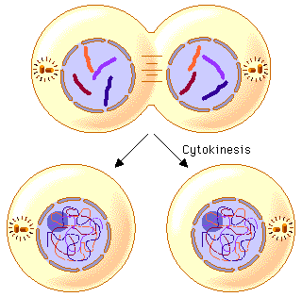
CYTOKINESIS:

Slide 17
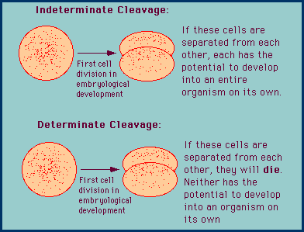
TYPES OF CLEAVAGE ON THE BASIS OF POTENTIALITY OF BLASTOMERES:

Slide 18
On the basis of potentiality of blastomeres:
Determinate:
Determinate cleavage also called mosaic cleavage is in most protostomes . It results in the developmental fate of the cells being set early in the embryo development.
Each blastomere produced by early embryonic cleavage does not have the capacity to develop into a complete embryo.
Indeterminate:
It is characteristic of deuterostomes
the original cell in a deuterostome embryo divides, the two resulting cells can be separated, and each one can individually develop into a whole organism.

Slide 19
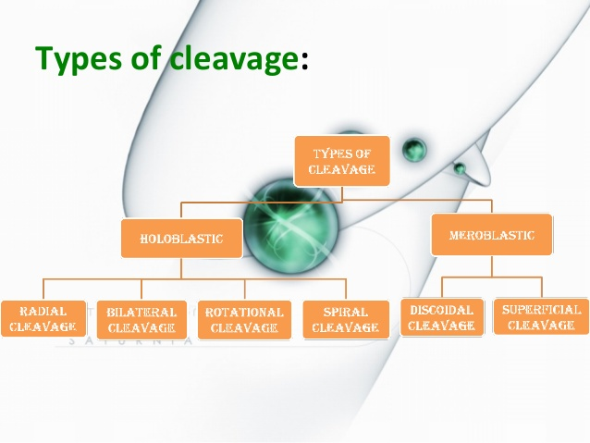
TYPES OF CLEAVAGE ON THE BASIS OF AMOUNT AND DISTRIBUTION OF YOLK:

Slide 20
On the basis of amount and distribution of yolk:
Holoblastic:
In holoblastic eggs, the first cleavage always occurs along the vegetal-animal axis of the egg, the second cleavage is perpendicular to the first. From here, the spatial arrangement of blastomeres can follow various patterns, due to different planes of cleavage, in various organisms.
Four major cleavage types can be observed in isolecithal cells (cells with a small even distribution of yolk) or in mesolecithal cells (moderate amount of yolk in a gradient)
bilateral holoblastic
radial holoblastic
rotational holoblastic
spiral holoblastic cleavage.

Slide 21
Bilateral:
The first cleavage results in bisection of the zygote into left and right halves.
The following cleavage planes are centered on this axis and result in the two halves being mirror images of one another.
In bilateral holoblastic cleavage, the divisions of the blastomeres are complete and separate.
Radial cleavage :
is characteristic of the deuterostomes, which include some vertebrates and echinoderms,
the spindle axes are parallel or at right angles to the polar axis of the oocyte.
Rotational:
Mammals display rotational cleavage.
Rotational cleavage involves a normal first division along the meridional axis, giving rise to two daughter cells.
The way in which this cleavage differs is that one of the daughter cells divides meridionally, whilst the other divides equatorially.

Slide 22
Spiral:
It is found in flatworms,annelids and mollusk.
In this cleavage the mitotic apparatus is tilted with respect to the animal vegetal axis and the blastomeres are arranged in spiral manner.
The mitotic apparatus is usually tilted clockwise.
The right handed or clock wise displacement of the micromeres is called dextral spiral cleavage .
The left handed or anticlockwise displacement of micromeres is called sinistral spiral cleavage.

Slide 23
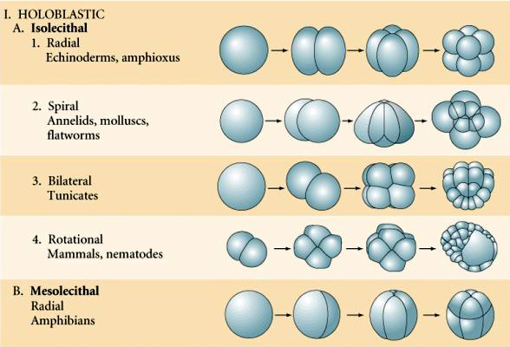
TYPES OF HOLOBLASTIC CLEAVAGE:

Slide 24
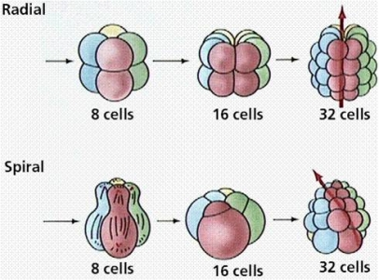

Slide 25
Meroblastic:
Two major types of meroblastic cleavage are discoidal and superficial.
Discoidal:
In discoidal cleavage, the cleavage furrows do not penetrate the yolk.
The embryo forms a disc of cells, called a blastodisc, on top of the yolk.
Discoidal cleavage is commonly found in monotremes, birds, reptiles, and fish that have telolecithal egg cells (egg cells with the yolk concentrated at one end).
Superficial:
In superficial cleavage, mitosis occurs but not cytokinesis, resulting in a polynuclear cell.
With the yolk positioned in the center of the egg cell, the nuclei migrate to the periphery of the egg, and the plasma membrane grows inward, partitioning the nuclei into individual cells.
Superficial cleavage occurs in arthropods that have centrolecithal egg cells (egg cells with the yolk located in the center of the cell.

Slide 26
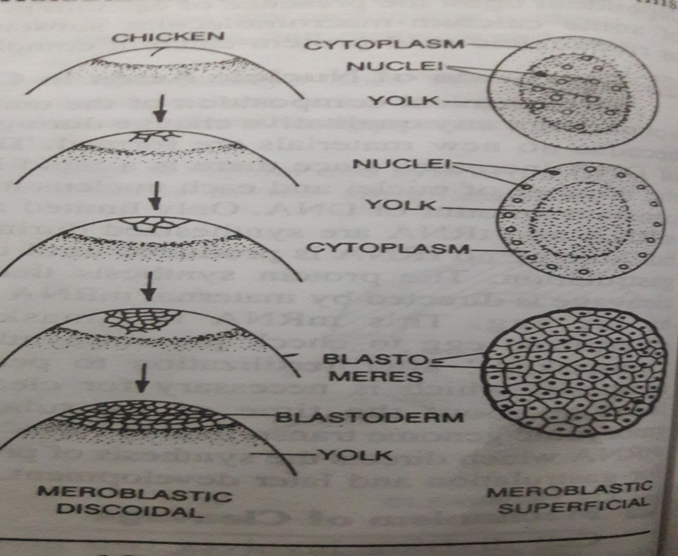

Slide 27
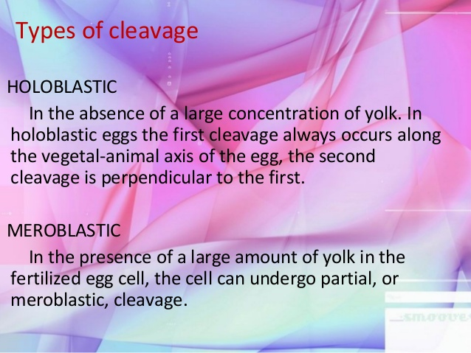
HOLOBLASTIC VS MEROBLASTIC CLEAVAGE:

Slide 28
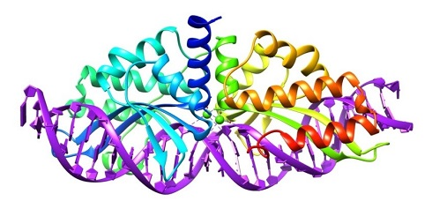
THANKS

